Slide 1
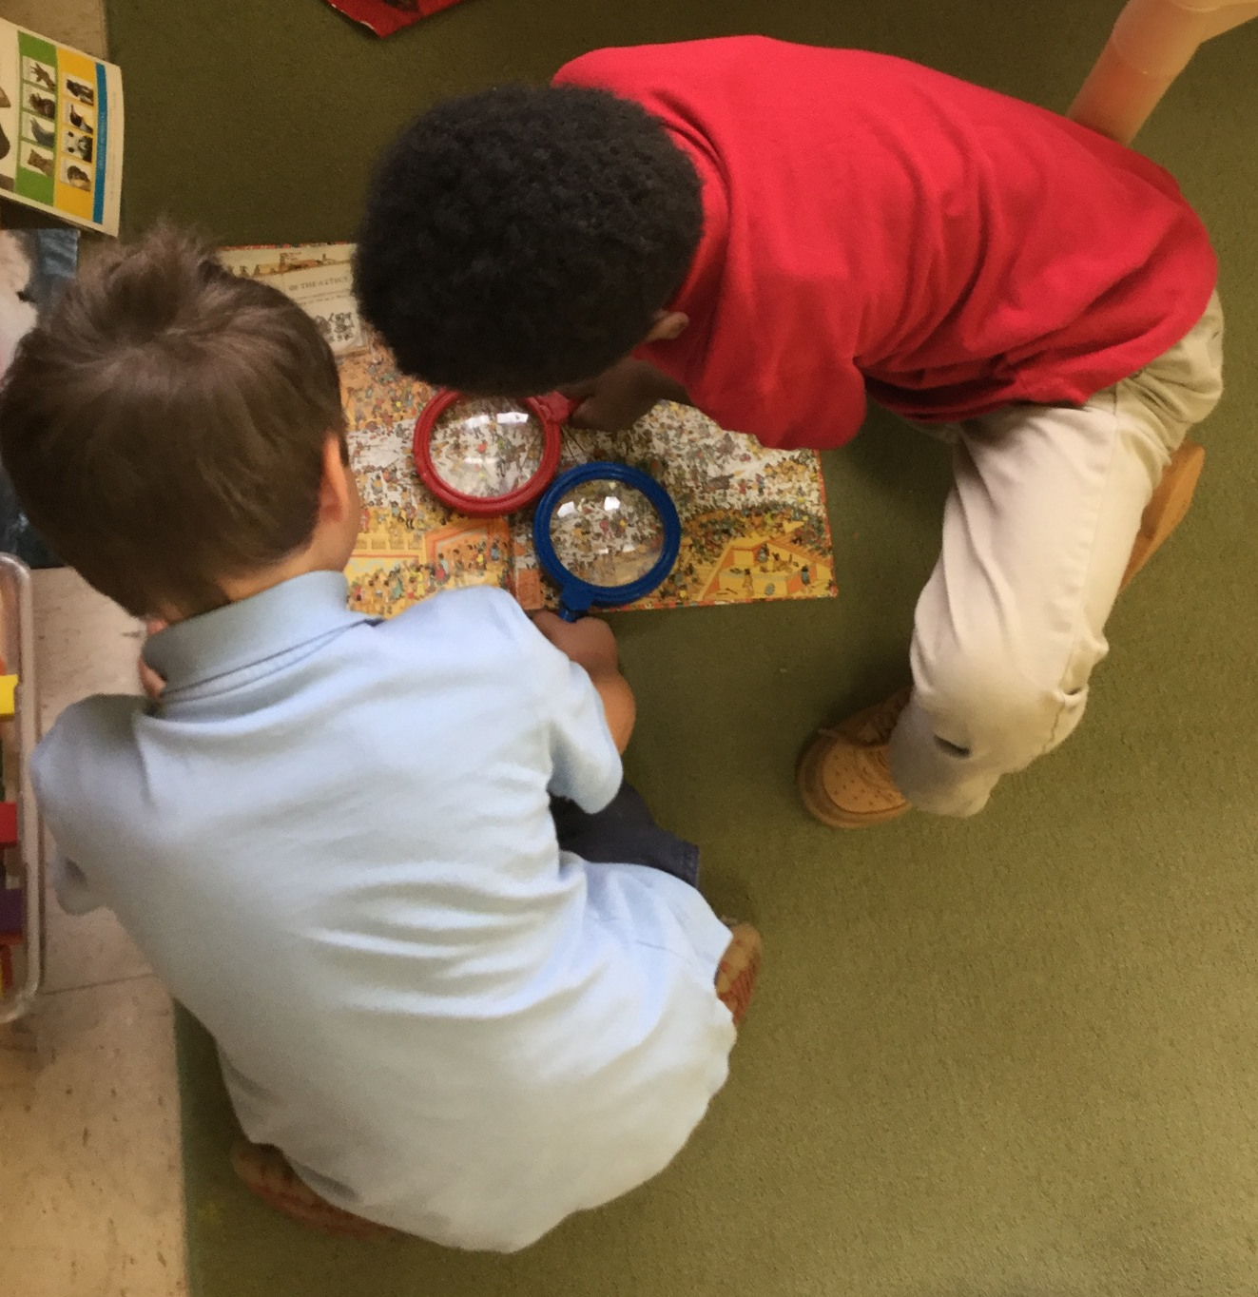
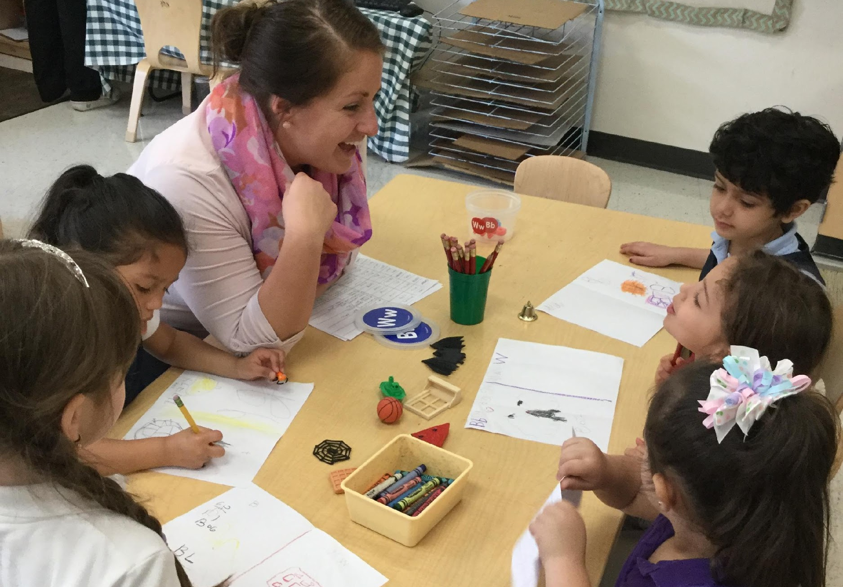
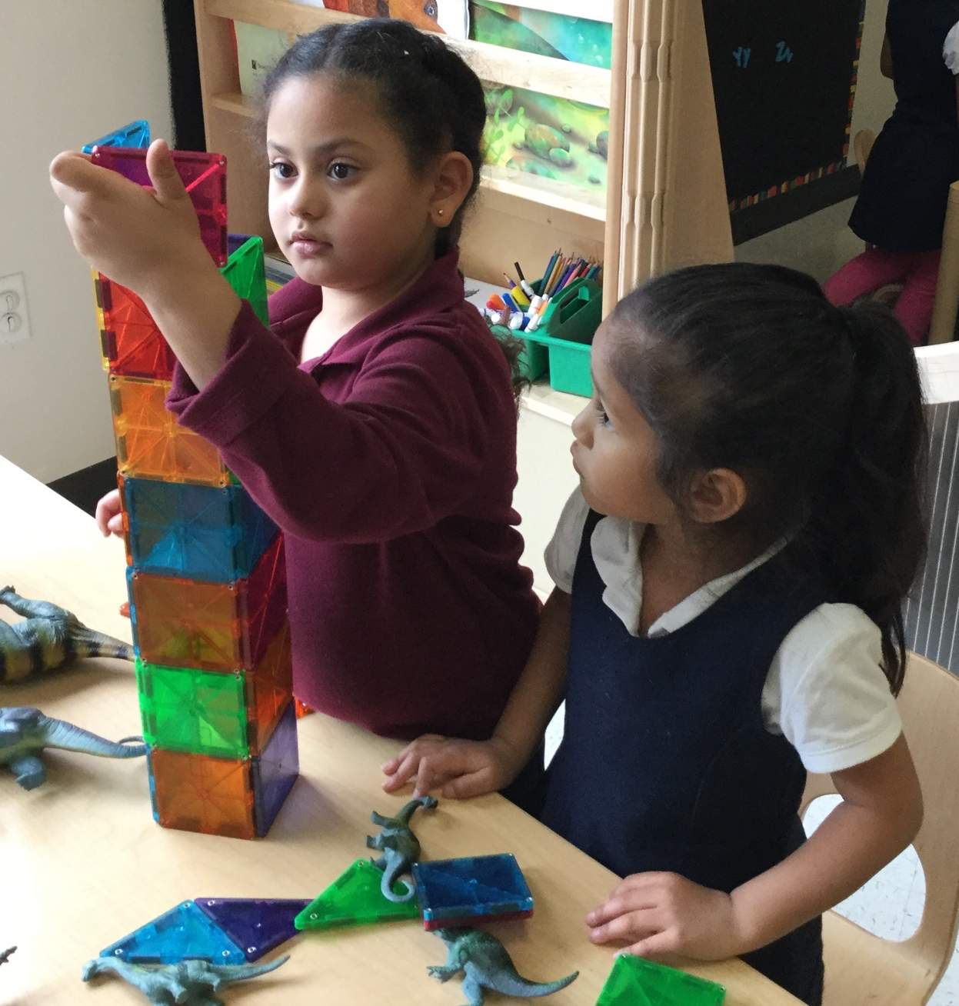
Improving Level of Instruction
CHALK PROFESSIONAL DEVELOPMENT SERIES

Slide 2

THE “MAGIC 8” CLASSROOM PRACTICES
Reduce time spent in transition
Improving level of instruction
Creating a positive climate
Increasing teacher listening to children
Planning sequential activities
Promoting associative and cooperative interactions
Fostering high levels of engagement
Providing math opportunities
★ 2017-18 Initiative: Focus on Literacy ★

Slide 3


WHY LEVEL OF INSTRUCTION MATTERS
Breakdown of Instruction in Pre-K
Classrooms
21%
71%
8%
Low
Level
Basic Skills
Instruction
Inferential
Instruction
Children in classrooms with teachers who engaged in higher levels of instruction demonstrated greater gains in:
BASIC SKILLS INSTRUCTION | INFERENTIAL INSTRUCTION
Requires children to…
Give the right answer (e.g., recite facts, identify objects) | Draw from experiences, background knowledge, context clues
Sit quietly and take in new information (e.g., listen to a story) | Actively construct links between experiences and ideas, past/present content; interact with peers and teachers
Letter & Sight Word Recognition
Self-Regulation
Early Math*
Vocabulary*
Early Writing*
*Stronger effects for children who entered pre-k with lower skills than their peers.
DISCUSSION POINT:
Why is higher level instruction especially beneficial for children who entered pre-k with lower skills than their peers?

Slide 4





UNPACKING LEVEL OF INSTRUCTION
Most instruction observed in Pre-K is at a “Basic Skills” level.
Low Level Instruction
Assisting with developmental demands of fine and gross motor activities
Helping spread glue or hold scissors
Singing along to a song without a clear academic focus
Basic Skills Instruction
Asking questions with predetermined answers, with the goal of having children learn or recite the correct response
What sound does “g” make?
Do we have more boys or girls here today?
Inferential Instruction
Exploring a topic using authentic, open-ended questioning with several turns
What do you think is going to happen next?
Why do you think that?
Katie, do you agree with Sean’s prediction? Why not?
DISCUSSION POINT:
What are some supports within your curriculum for achieving a higher level of instruction?
Notes:
Discussion cards that accompany most books within Creative Curriculum have great inferential questions
Ask teachers to give more examples

Slide 5

MOVING BEYOND BASIC SKILLS
The key to moving beyond basic skill instruction is to help children make inferences. Inferential questions are open-ended, have more than one possible answer, and require abstract thought.
How do you know...?
Why do you think...?
What makes you say…?
TRY ASKING CHILDREN TO…
Explain
their thought process to a teacher or peer
Tell your friend about a time when you…
Predict
based on context clues or prior knowledge
Connect
content with personal experiences
What would happen if…?
How could we…?
Reflect
back on parts of previous activities or lessons
DISCUSSION POINT:
What is a recent activity where you could have used the above strategies to increase level of instruction?
What do you remember about …?
What was your favorite part of…?
Notes:
While some Basic Skill instruction is necessary in preschool, research shows that young minds also thrive when they have opportunities to think more deeply. The key to moving beyond basic skill instruction is to help children make inferences.
Plan for teachers – video/document own practice, share observations

Slide 6

SPECIAL THANKS & ADDITIONAL RESOURCES
We are grateful to the following MNPS Pre-K Instructional Coaches and Multi-Classroom Leaders for their invaluable feedback in developing these materials:
SeTara DeThrow
Carrie Head
Susan McClain
Stephanie Mullins
Holly Stone
Ashley Aldridge Wilson
Rhiannon Wilson
https://my.vanderbilt.edu/mnpspartnership/

Slide 7
INDIVIDUAL IMAGE SOURCES
FREQUENTLY USED IMAGES*
ADDITIONAL IMAGE SOURCES
Lightbulb | myiconfinder.com
Designed by Vexels.com:
Hand drawn magnifying glass
Hand drawn bar graph
Pie chart hand drawn doodle
Hand drawn wall clock
Hand drawn cloud bubble
Hand drawn open book
Cog wheel hand drawn icon
Slide 4: glue | clker.com; scissors, music notes, beaker | kisspng.com
*These graphics are used as icons throughout the series. For example this lightbulb clipart appears beside most “Discussion Point” questions.

